Slide 1


Our Foundation
RLI - Part 1
Notes:
Begin the session:
Introduce self
Describe format for the session
For the next 15 or 20 minutes or so we will address any questions you might have and clarify any confusion about the Rotary Foundation.
Talk about what materials are available and/or where they can be found

Slide 2
Goals:
Discuss
Understand the basic goals and programs of the Rotary Foundation
Explore
Explore funding model of RI and TRF
Understand
Discuss ways Rotarians are involved in foundation programs
Reflect
Reflect on ways in which members use accumulated foundation points

Slide 3
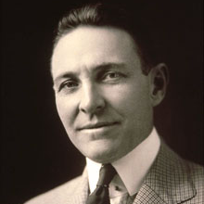
Arch Klumpf
RI President 1916 – 1917
Known as the Father of TRF
Charitable Arm of Rotary
Arch Klumpf established in 1917
First Contribution $26.50
$500 International Society for Crippled Children
2019 - $5 Billion
‘To Do Good in the World’ is the MISSION
Notes:
Share/Review information about founder Archibald Klumpf and the beginnings of The Rotary Foundation.
2. Value of $26.50 from 1917 to 2022
$26.50 in 1917 is equivalent in purchasing power to about $575.44 today, an increase of $548.94 over 105 years. The dollar had an average inflation rate of 2.97% per year between 1917 and today, producing a cumulative price increase of 2,071.47%.

Slide 4
Rotary International vs. Rotary Foundation
RI – Board of Directors
Non-profit 501c4
Membership pays Dues
Club dues supports RI, District, Club activities and Service
Motto – Service Above Self
TRF – Board of Trustees
Charitable 501c3
Funded through Donations
Annual Fund Donations funds GRANTS
Areas of Focus prioritize World Needs
Mission – Doing Good in the World
Notes:
Clarify the differences between Rotary International and The Rotary Foundation using the bullet point on the slide.
501c3 vs 501c4
Point out that The Rotary Foundation is considered a 4-STAR Charity which is the highest level given by Charity Navigator

Slide 5
Funding Model
Council on Legislation (COL)
Board of Directors Board of Trustees
Zone
District
Rotary International
501c4
Rotary Foundation
501c3
Dues
Contributions
Club
Notes:
Review and discuss the funding model referring to some of the poll responses.
Walk the group through the route the money (DUES vs. CONTRIBUTIONS) takes to the respective organizations.
Funding of RI is through membership dues while the Rotary Foundation is financed through voluntary contributions.
IRS requires separation between Rotary International and The Rotary Foundation. The two organizations have different tax status’s defined by IRS

Slide 6

The Giving Tree
Endowment Fund (Savings Account)
Annual Fund (Checking Account)
Polio Plus (Restricted Fund)
Notes:
Point out the three separate funds to which donations go when contributed to The Rotary Foundation
Annual Fund – comparable to a “checking account”
Endowment Fund – much like a “savings account” that accrues interest which provides perpetual support to Rotary programs supplementing Annual Fund
Polio Plus – restricted fund goes directly to eradication of polio
Let participants know that the specifics of how the money flows is further described in Part 2 – Targeted Service.

Slide 7

POLL
Foundation Donations
What are the ways in which members of your club donate to The Rotary Foundation?
Club Dues Invoice
Check to The Rotary Foundation
Rotary Direct
Club Contribution to Disaster Relief Designated Fund
Donation to Polio Plus Fundraiser
Launch Poll
Notes:
Launch the poll shown on the slide. Use the results of the poll as a basis for a discussion.
Review the ways in which individual Rotarians contribute to the Rotary Foundation by commenting on the results of the poll

Slide 8
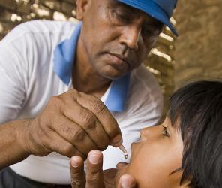
Donate | Rotary International
https://www.rotary.org/en/donate
Notes:
Engage the participants by taking them to The Rotary Foundation Website. (https://www.rotary.org/en/donate)
Direct them to open another tab on their browser or on their phone and log into www.rotary.org/en/donate
FOR TWO DAY EVENT - Present website and encourage folks to access it before the next day and explore it. Introduce the next day’s session by asking how folks discovered. Continue with number 2
Scroll down to the Rotary Direct box and click on that link to illustrate how to donate through the foundation using Rotary Direct. (Rotary Direct | My Rotary )
Provide directions for the participants to navigate the through the website along with you

Slide 9

Notes:
Have the participants to use the ANNOTATION TOOLS and put a circle around the most recently added Area of Focus. Use their choices as a basis for discussion of the Seven Areas of Focus.
What’s an example of a project that you are aware of in which your club or another club participate? Into what area of focus does it fall?
Briefly delineate the SEVEN Areas of Focus on which Global Grants and District Grants are based.
Point out that “Supporting the Environment” was added in July 2020 as the 7th Area of Focus

Slide 10
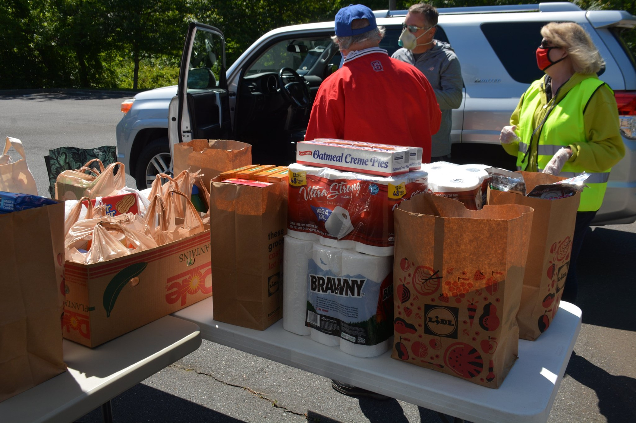
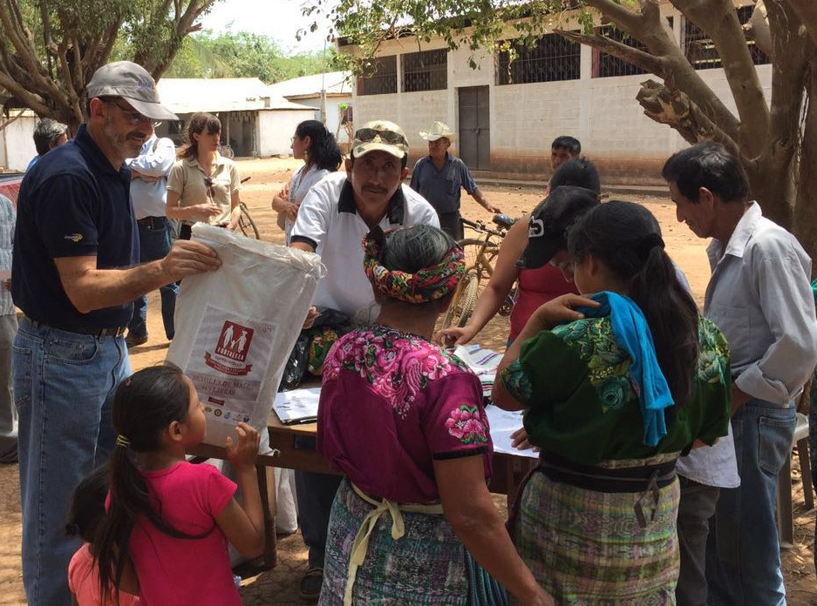
Rotary Foundation Programs
GRANTS
  District
  Global
EDUCATION
  Vocational Training Teams
  Global Scholarships
  Peace Fellowships
  District Scholarships
Notes:
Form Breakouts- share any grants in which your club is participating
Choose spokesperson
Are they district or global?
Who are the primary recipients
Does it address an area of focus? Which one?
Share with each other – choose one to share
Humanitarian Grants are categorized into District and Global. The funding is allocated for District and Global Grants differently.
District Grants
Local or international activities
Local decision making, broader guidelines
Smaller activities and projects
Global Grants
Align with one of the Areas of Focus
Long term, sustainable benefits
Measurable results
Budgets of at least $30,000
Educational Programs
VTT – Vocational Training Teams
Global Scholarships
Peace Fellowships
District Scholarships

Slide 11
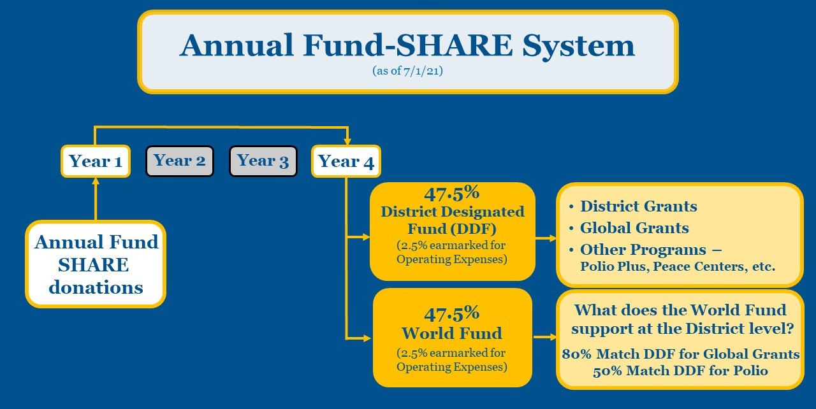
Rotary International Strategic Plan
THE ANNUAL FUND IS THE ENGINE THAT DRIVES OUR DISTRICT GIVING
Notes:
Show a sample schematic for how the contributions flow through the funding cycle. It illustrates how one district is set up (#3)
BRIEFLY DESCRIBE THE WAY IN WHICH MONEY FLOWS THROUGH THE FOUNDATION TO FUND PROGRAMS. You may include the following information in your description
Contributions to TRF are made to the Annual Fund if not otherwise indicated.
TRF holds (invests) the funds for three (3) years
After three years 50% of the original investment goes back to the district (DDF) and 50% goes to the World Fund
Funds are then used for foundation related programming both community and global
Each district determines how to distribute their District Designated Funds - DDF. (One example is given on the slide).
Participants should contact their District Foundation/Grant committee to determine how funds are sed in their district
Multiplier effect – individual contributions are combined to realize impacts that no one individual could possibly have.
Rotarians pledge to “Do Good in the World” is increased by the impact the Foundation can have.
Encourage participants to peruse the Foundation website to discover how TRF lives up to its promise https://www.rotary.org/en/about-rotary/rotary-foundation -

Slide 12

Recognition Levels
VIEW VIDEO – Rotary Foundation Recognition Points
Notes:
Rotarians donate their time and financial support for selfless reasons – Service Above Self.
The Rotary Foundation has many recognition levels both at the Individual and Club level to show appreciation for this support. Examples of recognition levels depicted on slide.
INDIVIDUAL
Rotary Foundation Sustaining Member ($100/year)
Benefactor – Endowment Fund in Will ($1000)
Paul Harris Fellow ($1000)
Multiple Paul Harris Fellow (each additional $1000)
Paul Harris Society ($1000/year)
Bequest Society (Future gifts of $10,000+)
Major Donor ($10,000 +)
Arch Klumpf ($250,000)
Legacy Society ($1 million)
CLUB
100% Paul Harris Fellow
100% Paul Harris Society
100% Rotary’s Promise – All members support Endowment
Every Rotarian Every Year - EREY
Have YouTube Video open in another tab. Share screen and optimize sound in screensharing. Show video “Rotary Foundation Recognition Points” which shows how points are accumulated and used. (https://www.youtube.com/watch?v=PlnLMoTtowA)

Slide 13



Resources for Rotarians
https://my.rotary.org/en/document/rotary-foundation-reference-guide
Notes:
Share the foundation resource.
The Rotary Foundation Reference Guide provides a lot of information about grants, programs and all things Foundation.
It can be downloaded at: https://my.rotary.org/en/document/rotary-foundation-reference-guide.

Slide 14

Rotary International Strategic Plan
The Rotary Foundation…
transforms your gifts into service projects that change lives both close to home and around the world.
Key Take Away?
Notes:
Ask the group to reflect on what they learned about the foundation.
What is something you discovered about the Rotary Foundation that you can take back to your club. Using your Virtual Hand and unmute to offer your thoughts.

Slide 15
Summary
The Rotary Foundation – founded to “DO GOOD IN THE WORLD”
Clubs use District and Global Grants to help people in need locally and globally
Funding comes from Rotarians, Clubs, Districts, and friends who contribute to TRF (Annual Fund, Polio Plus, Endowment Fund)
Notes:
Summarize the session and online experience.

